Slide 1
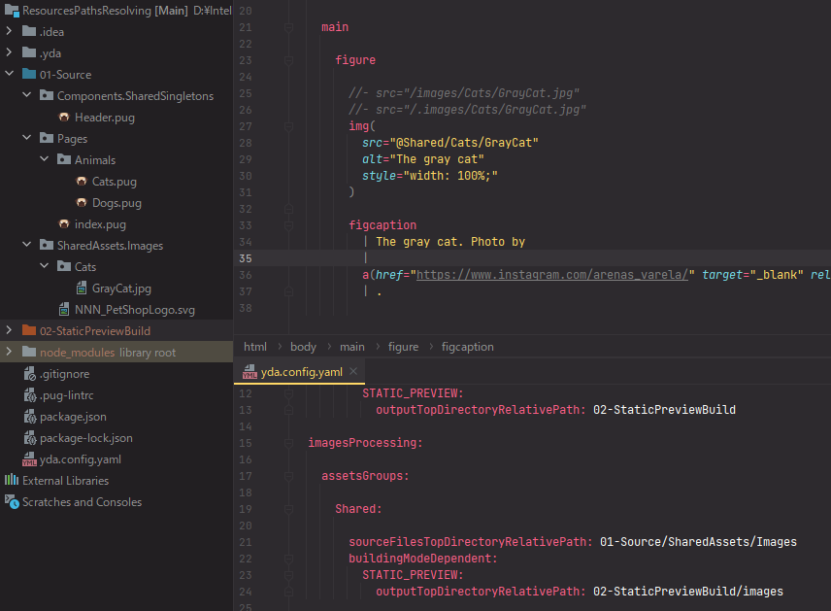

Slide 2
Reference prefix
@Shared/Cats/GrayCat.jpg
Resources group
reference
Path relative to top directory of source files of resources group
Optional file name extension

